Slide 1

SLAM
DS
VMM
Physical Machine

Slide 2
SLAM
1. DS is up
DS
VMM
Physical Machine

Slide 3
SLAM
2. SLAM is up
1. DS is up
DS
VMM
Physical Machine

Slide 4
SLAM
2. SLAM is up
3. SLAM registers
1. DS is up
DS
VMM
Physical Machine

Slide 5
SLAM
2. SLAM is up
3. SLAM registers
1. DS is up
4. VMM is up
DS
VMM
Physical Machine

Slide 6
SLAM
2. SLAM is up
3. SLAM registers
1. DS is up
4. VMM is up
DS
5. VMM registers
VMM
Physical Machine

Slide 7
SLAM
2. SLAM is up
3. SLAM registers
1. DS is up
6. VMM registers
4. VMM is up
DS
5. VMM registers
VMM
Physical Machine

Slide 8

SLAM
DS
VMM
Physical Machine
Physical Machine
Client

Slide 9
SLAM
DS
VMM
Physical Machine
Physical Machine
1. Registration
Client

Slide 10
SLAM
2. Find available machines
DS
VMM
Physical Machine
Physical Machine
1. Registration
Client

Slide 11
SLAM
2. Find available machines
DS
VMM
Physical Machine
Physical Machine
1. Registration
3. OK <SLAM IP list>
Client

Slide 12
SLAM
2. Find available machines
DS
VMM
Physical Machine
Physical Machine
4. Registration
1. Registration
3. OK <SLAM IP list>
Client

Slide 13
SLAM
2. Find available machines
DS
5. New VM request
VMM
Physical Machine
Physical Machine
4. Registration
1. Registration
3. OK <SLAM IP list>
Client

Slide 14
SLAM
2. Find available machines
DS
5. New VM request
6. Start VM
VMM
Physical Machine
Physical Machine
4. Registration
1. Registration
3. OK <SLAM IP list>
Client

Slide 15
SLAM
2. Find available machines
DS
5. New VM request
6. Start VM
VMM
Physical Machine
Physical Machine
4. Registration
1. Registration
3. OK <SLAM IP list>
7. Start AS
8. Register with VMM
Client

Slide 16
SLAM
2. Find available machines
DS
5. New VM request
6. Start VM
9. Registration
VMM
Physical Machine
Physical Machine
4. Registration
1. Registration
3. OK <SLAM IP list>
7. Start AS
8. Register with VMM
Client

Slide 17
SLAM
2. Find available machines
DS
5. New VM request
6. Start VM
10. OK <VM IP>
9. Registration
VMM
Physical Machine
Physical Machine
4. Registration
1. Registration
3. OK <SLAM IP list>
7. Start AS
8. Register with VMM
Client

Slide 18
SLAM
2. Find available machines
DS
5. New VM request
6. Start VM
10. OK <VM IP>
9. Registration
VMM
Physical Machine
Physical Machine
4. Registration
1. Registration
11. OK <VM IP>
3. OK <SLAM IP list>
7. Start AS
8. Register with VMM
Client

Slide 19
SLAM
2. Find available machines
DS
5. New VM request
6. Start VM
10. OK <VM IP>
9. Registration
VMM
Physical Machine
Physical Machine
4. Registration
1. Registration
11. OK <VM IP>
3. OK <SLAM IP list>
7. Start AS
8. Register with VMM
12. UD-VM registration phase
Client

Slide 20
SLAM
2. Find available machines
DS
5. New VM request
6. Start VM
10. OK <VM IP>
9. Registration
VMM
Physical Machine
Physical Machine
4. Registration
1. Registration
11. OK <VM IP>
3. OK <SLAM IP list>
7. Start AS
8. Register with VMM
12. UD-VM registration phase
13. Connection
Client

Slide 21
SLAM
2. Find available machines
DS
5. New VM request
6. Start VM
10. OK <VM IP>
9. Registration
VMM
Physical Machine
Physical Machine
4. Registration
1. Registration
11. OK <VM IP>
3. OK <SLAM IP list>
7. Start AS
8. Register with VMM
12. UD-VM registration phase
13. Connection
14. APK registration on the VM
Client

Slide 22
SLAM
2. Find available machines
DS
5. New VM request
6. Start VM
10. OK <VM IP>
9. Registration
VMM
Physical Machine
Physical Machine
4. Registration
1. Registration
11. OK <VM IP>
3. OK <SLAM IP list>
7. Start AS
8. Register with VMM
12. UD-VM registration phase
13. Connection
14. APK registration on the VM
15. RTT measurement
Client

Slide 23
SLAM
2. Find available machines
DS
5. New VM request
6. Start VM
10. OK <VM IP>
9. Registration
VMM
Physical Machine
Physical Machine
4. Registration
1. Registration
11. OK <VM IP>
3. OK <SLAM IP list>
7. Start AS
8. Register with VMM
12. UD-VM registration phase
13. Connection
14. APK registration on the VM
15. RTT measurement
Client
16. Download rate measurement

Slide 24
SLAM
2. Find available machines
DS
5. New VM request
6. Start VM
10. OK <VM IP>
9. Registration
VMM
Physical Machine
Physical Machine
4. Registration
1. Registration
11. OK <VM IP>
3. OK <SLAM IP list>
7. Start AS
8. Register with VMM
12. UD-VM registration phase
13. Connection
14. APK registration on the VM
15. RTT measurement
Client
16. Download rate measurement
17. Upload rate measurement

Slide 25
SLAM
2. Find available machines
DS
5. New VM request
6. Start VM
10. OK <VM IP>
9. Registration
VMM
Physical Machine
Physical Machine
4. Registration
1. Registration
11. OK <VM IP>
3. OK <SLAM IP list>
7. Start AS
8. Register with VMM
12. UD-VM registration phase
13. Connection
14. APK registration on the VM
15. RTT measurement
Client
16. Download rate measurement
17. Upload rate measurement
18. Registration completed!

Slide 26
SLAM
2. Find previous machine
6. Find previous
VM
DS
5. Prev VM request
7. OK <VM IP>
VMM
Physical Machine
Physical Machine
4. Registration
1. Prev VM request
8. OK <VM IP>
3. OK <SLAM IP>
9. UD-VM registration phase
10. Connection
11. APK registration on the VM
12. RTT measurement
13. Download rate measurement
14. Upload rate measurement
Client
15. Registration completed!

Slide 27
SLAM
2. Find previous machine
6. Find previous
VM
DS
5. Prev VM request
7. OK <VM IP>
VMM
Physical Machine
Physical Machine
4. Registration
1. Prev VM request
8. OK <VM IP>
3. OK <SLAM IP>
9. UD-VM registration phase
10. Connection
11. APK registration on the VM
12. RTT measurement
13. Download rate measurement
14. Upload rate measurement
Client

Slide 28
SLAM
2. Find previous machine
6. Find previous
VM
DS
5. Prev VM request
7. OK <VM IP>
VMM
Physical Machine
Physical Machine
4. Registration
1. Prev VM request
8. OK <VM IP>
3. OK <SLAM IP>
9. UD-VM registration phase
10. Connection
11. APK registration on the VM
12. RTT measurement
13. Download rate measurement
Client

Slide 29
SLAM
2. Find previous machine
6. Find previous
VM
DS
5. Prev VM request
7. OK <VM IP>
VMM
Physical Machine
Physical Machine
4. Registration
1. Prev VM request
8. OK <VM IP>
3. OK <SLAM IP>
9. UD-VM registration phase
10. Connection
11. APK registration on the VM
12. RTT measurement
Client

Slide 30
SLAM
2. Find previous machine
6. Find previous
VM
DS
5. Prev VM request
7. OK <VM IP>
VMM
Physical Machine
Physical Machine
4. Registration
1. Prev VM request
8. OK <VM IP>
3. OK <SLAM IP>
9. UD-VM registration phase
10. Connection
11. APK registration on the VM
Client

Slide 31
SLAM
2. Find previous machine
6. Find previous
VM
DS
5. Prev VM request
7. OK <VM IP>
VMM
Physical Machine
Physical Machine
4. Registration
1. Prev VM request
8. OK <VM IP>
3. OK <SLAM IP>
9. UD-VM registration phase
10. Connection
Client

Slide 32
SLAM
2. Find previous machine
6. Find previous
VM
DS
5. Prev VM request
7. OK <VM IP>
VMM
Physical Machine
Physical Machine
4. Registration
1. Prev VM request
8. OK <VM IP>
3. OK <SLAM IP>
9. UD-VM registration phase
Client

Slide 33
SLAM
2. Find previous machine
6. Find previous
VM
DS
5. Prev VM request
7. OK <VM IP>
VMM
Physical Machine
Physical Machine
4. Registration
1. Prev VM request
8. OK <VM IP>
3. OK <SLAM IP>
Client

Slide 34
SLAM
2. Find previous machine
6. Find previous
VM
DS
5. Prev VM request
7. OK <VM IP>
VMM
Physical Machine
Physical Machine
4. Registration
1. Prev VM request
3. OK <SLAM IP>
Client

Slide 35
SLAM
2. Find previous machine
6. Find previous
VM
DS
5. Prev VM request
VMM
Physical Machine
Physical Machine
4. Registration
1. Prev VM request
3. OK <SLAM IP>
Client

Slide 36
SLAM
2. Find previous machine
DS
5. Prev VM request
VMM
Physical Machine
Physical Machine
4. Registration
1. Prev VM request
3. OK <SLAM IP>
Client

Slide 37
SLAM
2. Find previous machine
DS
VMM
Physical Machine
Physical Machine
4. Registration
1. Prev VM request
3. OK <SLAM IP>
Client

Slide 38
SLAM
2. Find previous machine
DS
VMM
Physical Machine
Physical Machine
1. Prev VM request
3. OK <SLAM IP>
Client

Slide 39
SLAM
2. Find previous machine
DS
VMM
Physical Machine
Physical Machine
1. Prev VM request
Client

Slide 40
SLAM
DS
VMM
Physical Machine
Physical Machine
1. Prev VM request
Client

Slide 41
SLAM
DS
VMM
Physical Machine
Physical Machine
Client

Slide 42
SLAM
DS
VMM
Physical Machine
Physical Machine
4. Remote result
3. Run method on the VM
1. Prepare data
2. Offload <method> <data>
Client
5. Finished!

Slide 43
SLAM
DS
VMM
Physical Machine
Physical Machine
4. Remote result
3. Run method on the VM
1. Prepare data
2. Offload <method> <data>
Client

Slide 44
SLAM
DS
VMM
Physical Machine
Physical Machine
3. Run method on the VM
1. Prepare data
2. Offload <method> <data>
Client

Slide 45
SLAM
DS
VMM
Physical Machine
Physical Machine
1. Prepare data
2. Offload <method> <data>
Client

Slide 46
SLAM
DS
VMM
Physical Machine
Physical Machine
1. Prepare data
Client

Slide 47
SLAM
DS
VMM
Physical Machine
Physical Machine
Client

Slide 48

SLAM
DS
VMM
Physical Machine
Physical Machine
1. Prepare data
2. Run method on the device
Client
3. Finished!

Slide 49
SLAM
DS
VMM
Physical Machine
Physical Machine
1. Prepare data
2. Run method on the device
Client

Slide 50
SLAM
DS
VMM
Physical Machine
Physical Machine
1. Prepare data
Client

Slide 51
SLAM
DS
VMM
Physical Machine
Physical Machine
Client

Slide 52
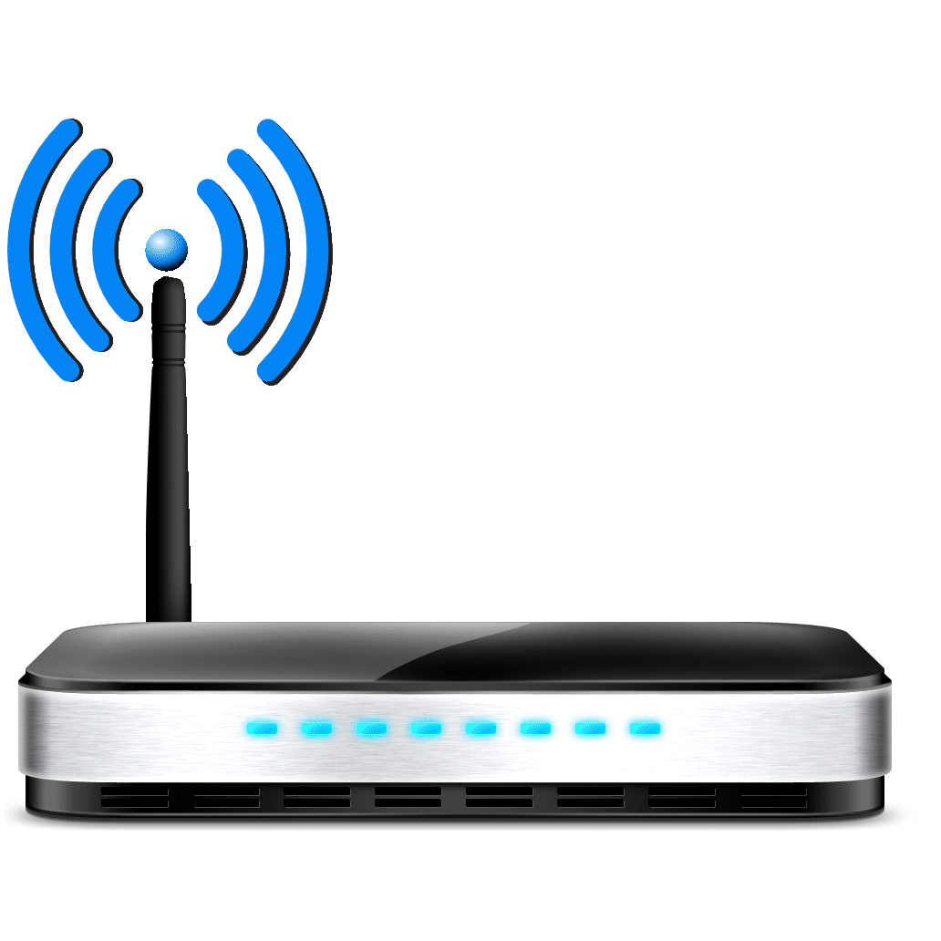
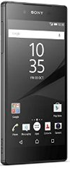
SLAM
DS
VMM
Physical Machine
Physical Machine
3. Run method
1. Prepare data
2. Offload <method> <data>
2. Offload <method> <data>
4. Result
4. Result
Client
5. Finished!
AC/AS

Slide 53
SLAM
DS
VMM
Physical Machine
Physical Machine
3. Run method
1. Prepare data
2. Offload <method> <data>
2. Offload <method> <data>
4. Result
4. Result
Client
AC/AS

Slide 54
SLAM
DS
VMM
Physical Machine
Physical Machine
3. Run method
1. Prepare data
2. Offload <method> <data>
2. Offload <method> <data>
Client
AC/AS

Slide 55
SLAM
DS
VMM
Physical Machine
Physical Machine
1. Prepare data
2. Offload <method> <data>
2. Offload <method> <data>
Client
AC/AS

Slide 56
SLAM
DS
VMM
Physical Machine
Physical Machine
1. Prepare data
Client
AC/AS

Slide 57
SLAM
DS
VMM
Physical Machine
Physical Machine
Client
AC/AS

Slide 58
SLAM
DS
VMM
Physical Machine
Physical Machine
Listening for D2D devices…
Broadcasting…
Client
Received!
AC/AS

Slide 59
SLAM
DS
VMM
Physical Machine
Physical Machine
Listening for D2D devices…
Broadcasting…
Client
AC/AS

Slide 60
SLAM
DS
VMM
Physical Machine
Physical Machine
Listening for D2D devices…
Client
AC/AS

Slide 61
SLAM
DS
VMM
Physical Machine
Physical Machine
Client
AC/AS

